Slide 1
Software Evolution
Lecture#3
Haroon Zafar
Department of Computer Science
National University of Computer and Emerging Science (NUCES)

Slide 2
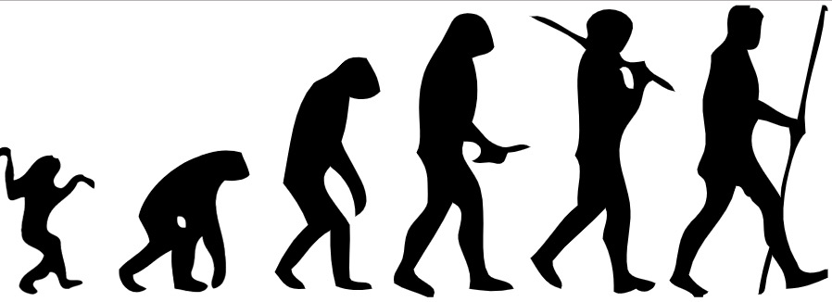
What is Evolution?
The gradual development of something.
“Evolution is what happens, while you’re busy making other plans”
The term evolution does not refer to changes that occurs in an individual within its life time. Instead it refers to the changes in the characteristic of population over the course of generation.
E.g. The Human Evolution Theory

Slide 3
Importance of Evolution
Organizations have huge investment in their software systems, they are critical business assets.
To maintain the value of these assets to the business, they must be changed and maintained.
Organizations prefers evolution over new development.

Slide 4
Software Evolution
Evolution actually happens by two major things
Software Change
Software maintenance

Slide 5
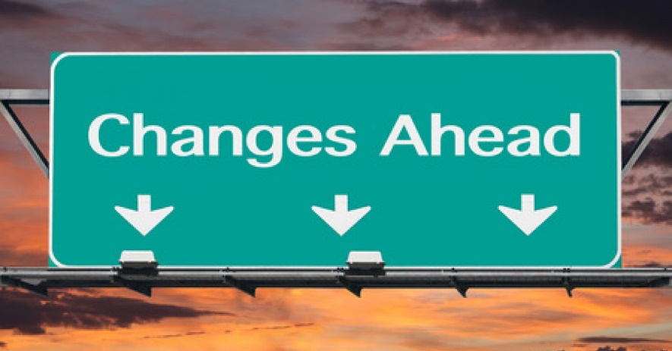
Strategies for changing software systems
Software Maintenance
Architectural Evolution
Software re-engineering

Slide 6
Software Maintenance
Maintenance does not normally involve major changes to the system’s architecture
The system requirement are likely to change while the system is being developed because the environment is changing. Therefore a delivered system won’t meet its requirement.
Systems are tightly coupled with their environment. When a system is installed in an environment it changes that environment and therefore changes the system requirements.
The system must be maintained therefore if they are to remain useful in an environment.

Slide 7
Types of Maintenance
Corrective
Maintenance to repair software faults
Adaptive
Maintenance to the software to adapt different operating environment
Perfective
Maintenance to add or modify the new business requirements

Slide 8
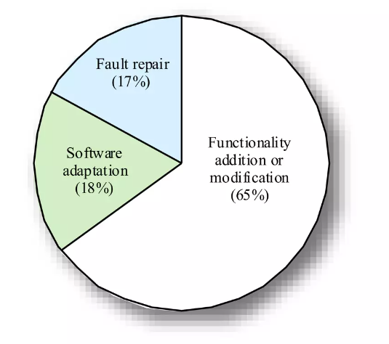
Distribution of maintenance effort
Maintenance Prediction

Slide 9
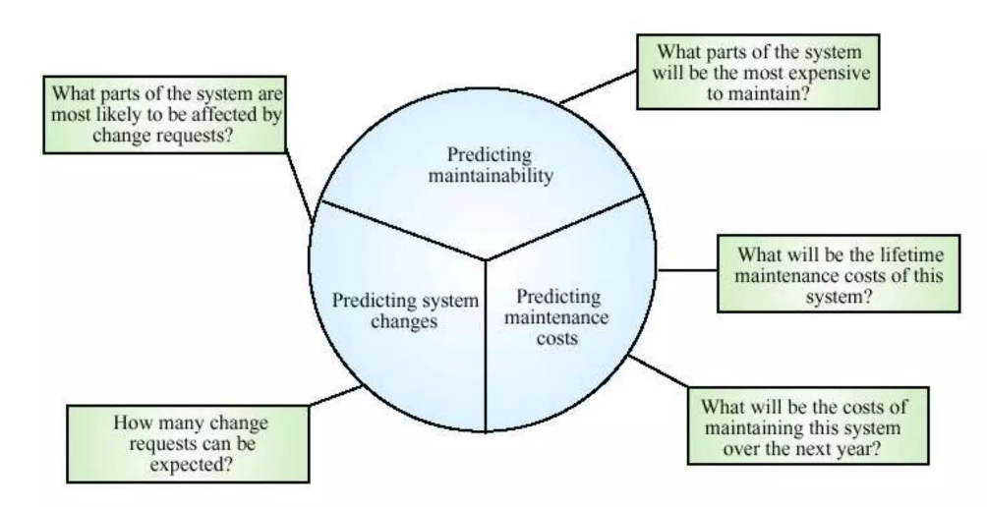
Maintenance Prediction

Slide 10
Change Request
Change request are for system changes suggested by the users, customers or the management
In principle, all the requests should be carefully analyzed as the part of the maintenance process and then implemented.
In practice, some changes request must be implemented urgently.
Fault repair
Changes to the system‘s environment
Urgently required business changes

Slide 11
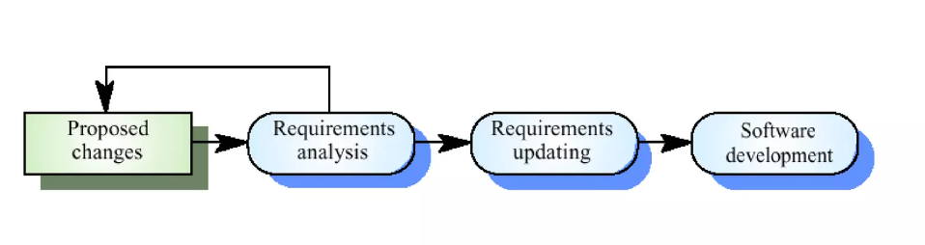
Change Implementation

Slide 12
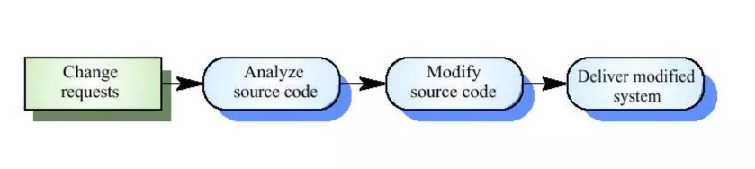
Emergency Change

Slide 13
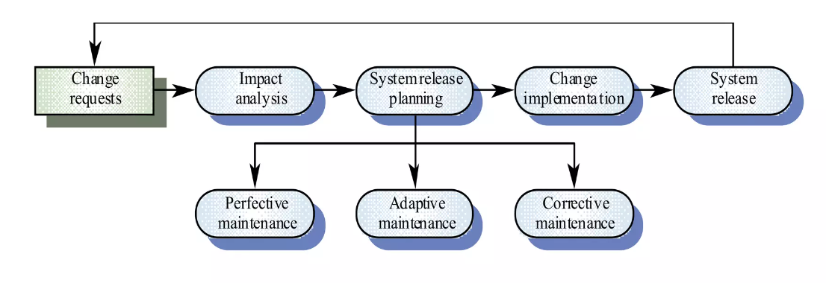
Software Maintenance Process

Slide 14
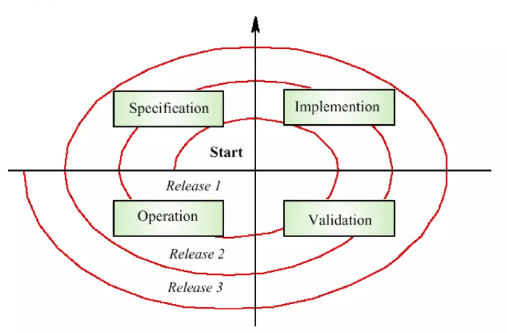
Spiral Maintenance Model

Slide 15
Architectural Evolution
There is a need to convert many legacy system from a centralized architecture to a client-server architecture
Change drivers
Hardware costs, servers are cheaper than mainframes
User interface expectations. User expect graphical user interfaces
Distributed access to system. User wish to access the system from different geographically separated, computers

Slide 16
Legacy systems categories
Low quality, low business value
These system should be scrapped.
Low-quality, high-business value
These make an important business contribution but are expensive to maintain. Should be re engineered or replaced if a suitable system is available.
High quality, low-business value
Replace with COTS, scrap completely or maintain
High quality, high business value
Continue in operation using normal system maintenance

Slide 17
Legacy System Structure
Ideally, for distribution there should be a clear separation between the user interface, the system services and the system data management
In practice, these are usually intermingled in older legacy system.

Slide 18
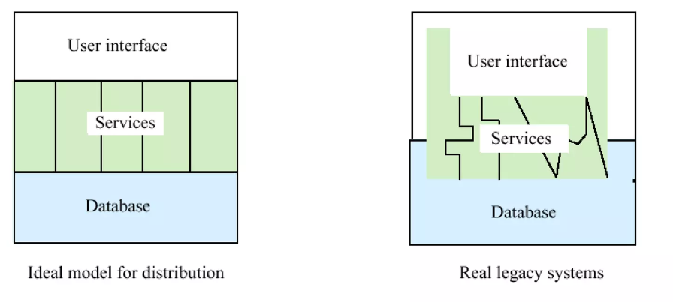
Legacy System Structure (Cont…)

Slide 19
System Re-engineering
Re-structuring or re-writing part or all of a legacy system without changing its functionality
Applicable where some but not all sub-system of a larger system require frequent maintenance.
Re-engineering involves adding effort to make them easier to maintain.
The system may be re-structured and re-documented.

Slide 20
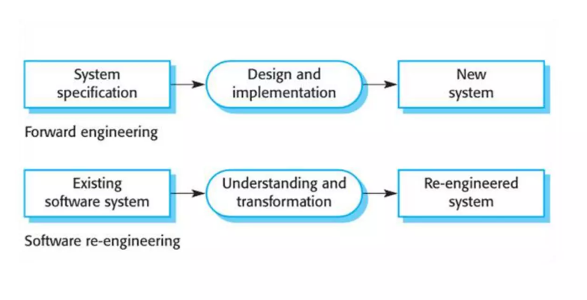
Forward Engineering v/s Re-engineering

Slide 21
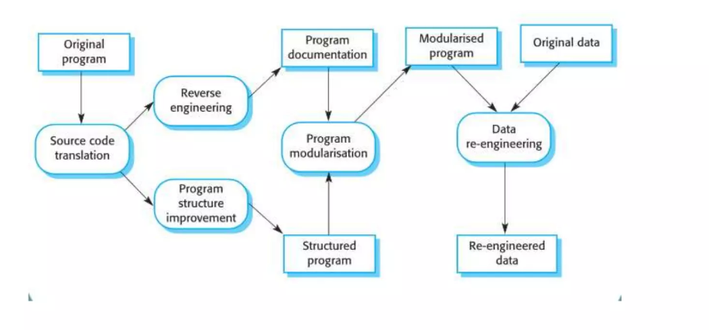
Re-engineering Process

Slide 22
Re-engineering process activities
Source code translation
Convert code to a new language
Reverse Engineering
Analyze the program to understand it.
Program structure improvement
Restructure automatically for understandability
Program modularization
Re-organize the program structure
Data re-engineering
Cleanup and restructure system data

Slide 23
Reverse Engineering
Analyzing software with a view to understand the system design and specification
May be part of a re-engineering process but may also be used to re-specify a system for re-implementation.
Build a program database and generated information for this.
Program understanding tools may be used in the process.

Slide 24
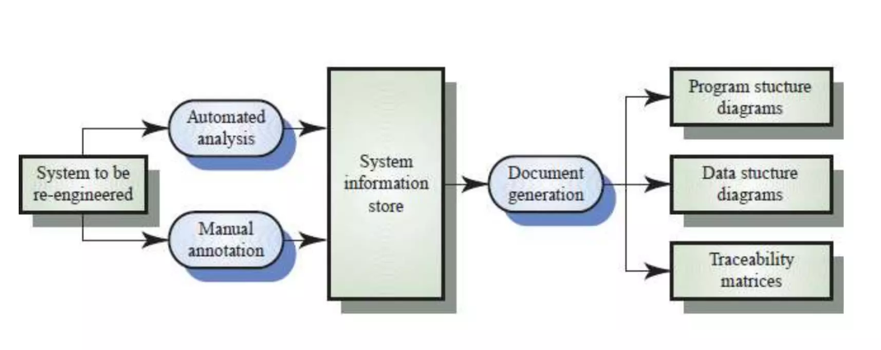
Reverse Engineering (Cont…)

